Slide 1
Prize giving
2010
Our girls in action

Slide 2
NETBALL

Slide 3
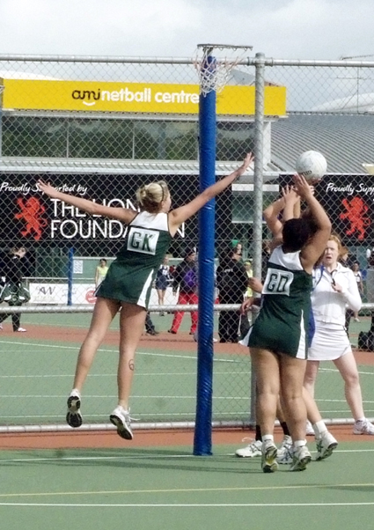
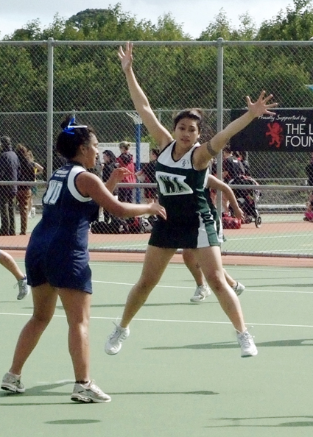

Slide 4
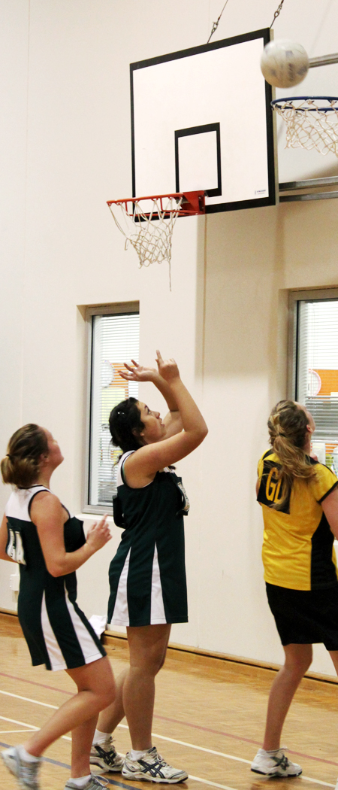
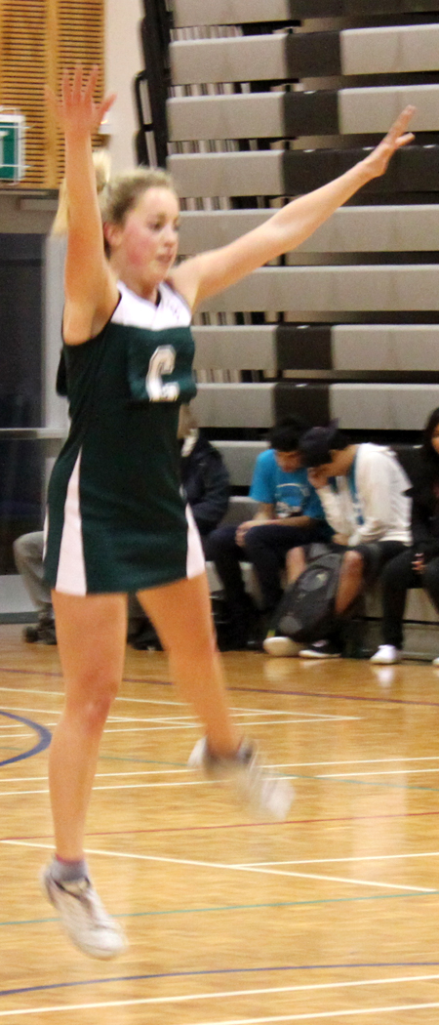
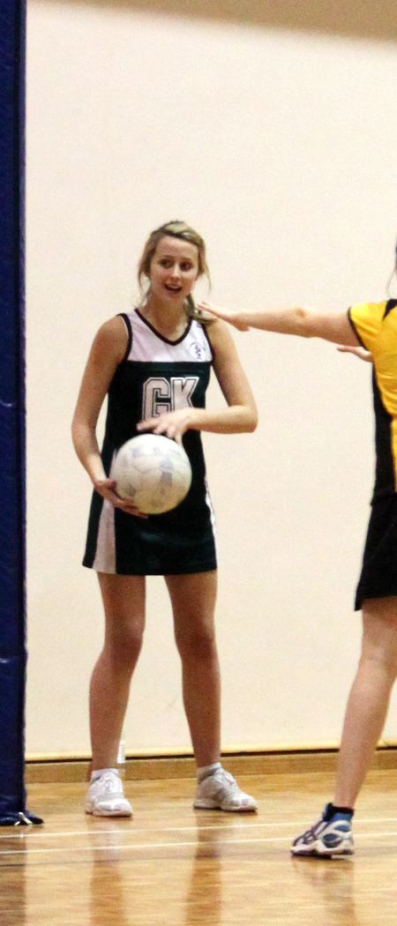
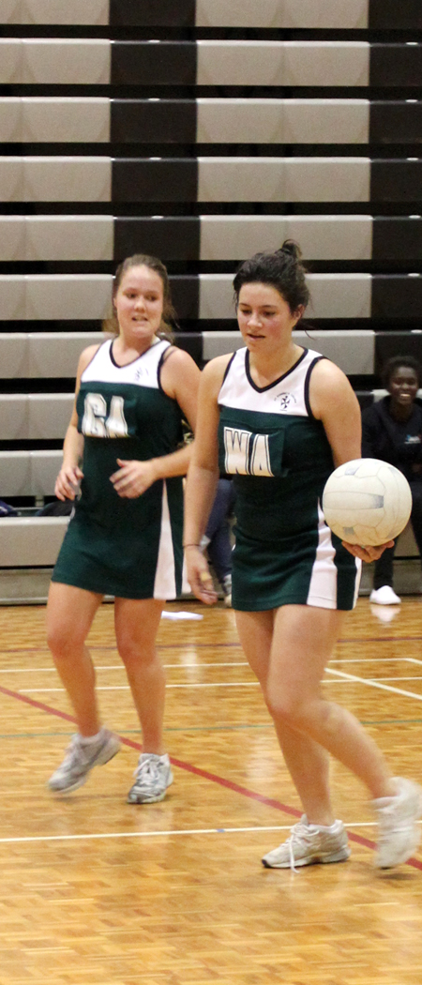

Slide 5
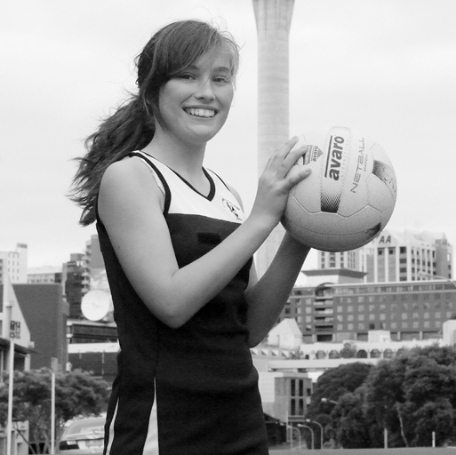
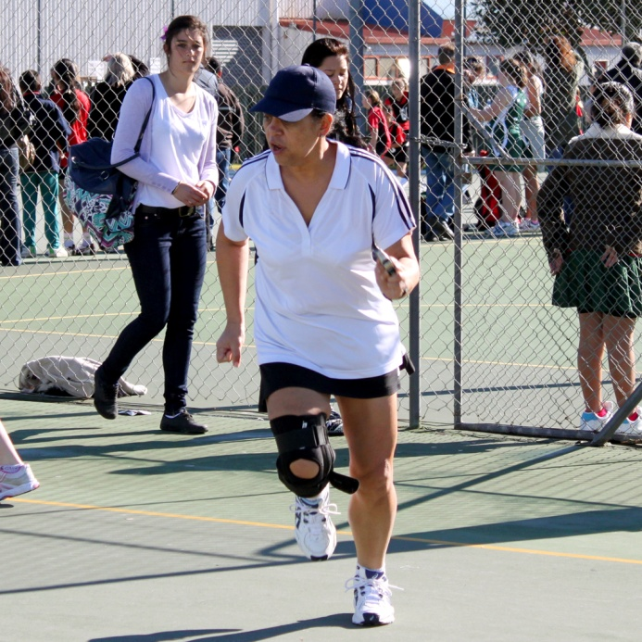
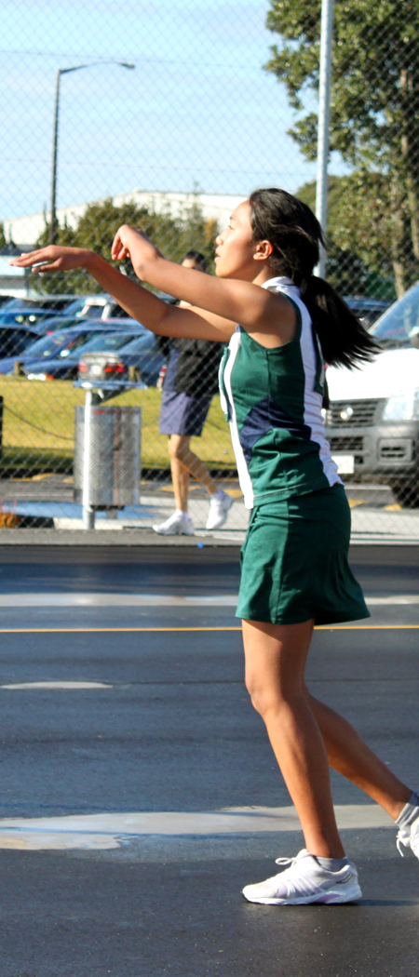
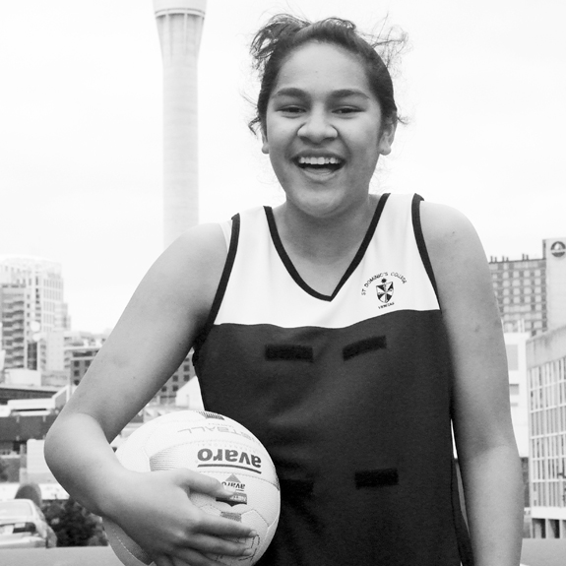
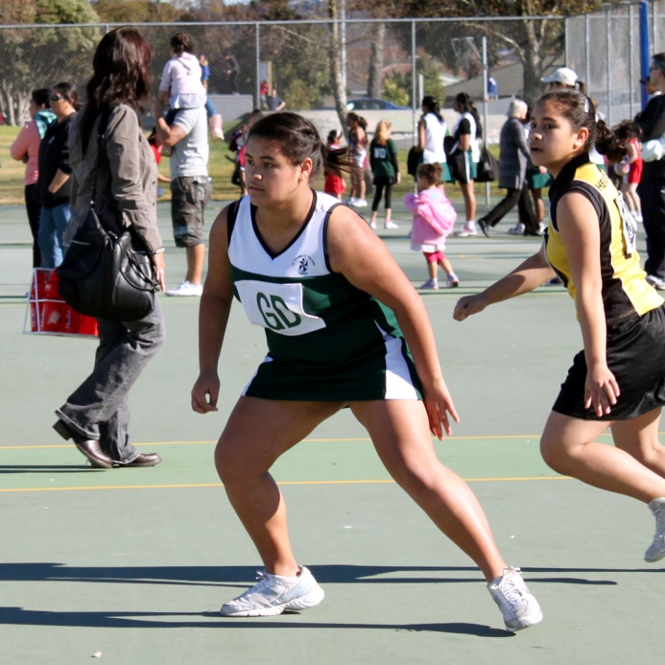

Slide 6
SOCCER

Slide 7
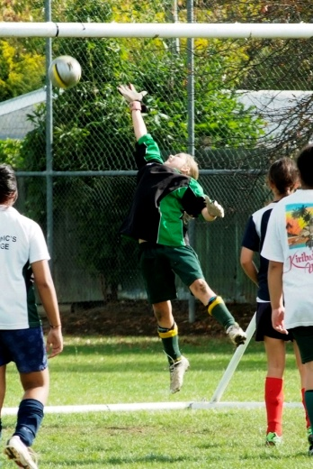
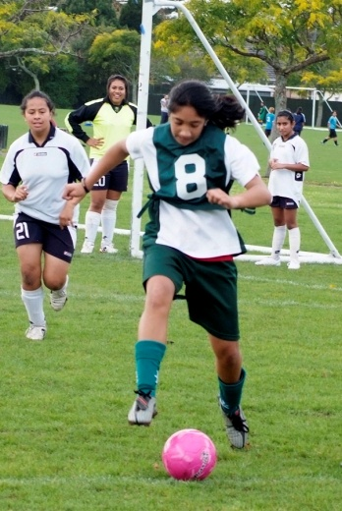
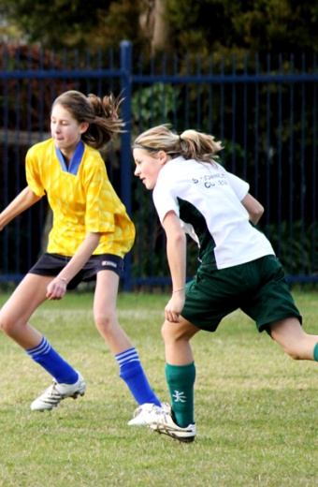
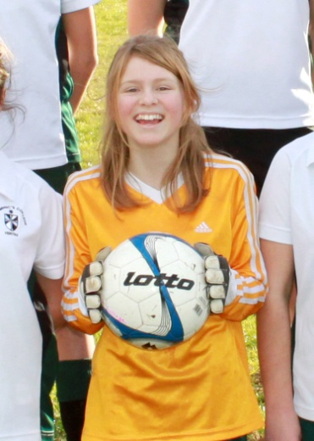
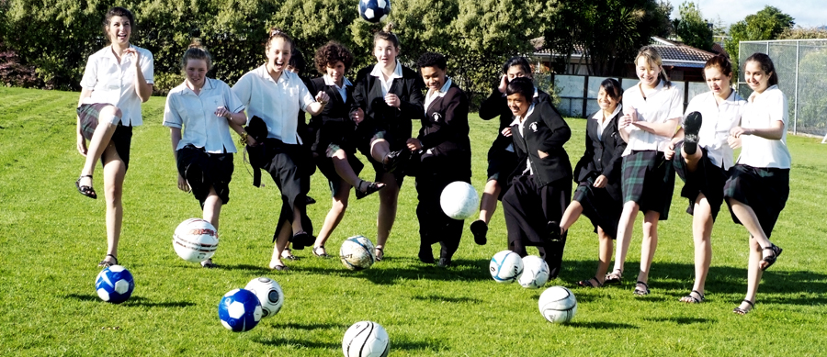

Slide 8
BASKETBALL

Slide 9
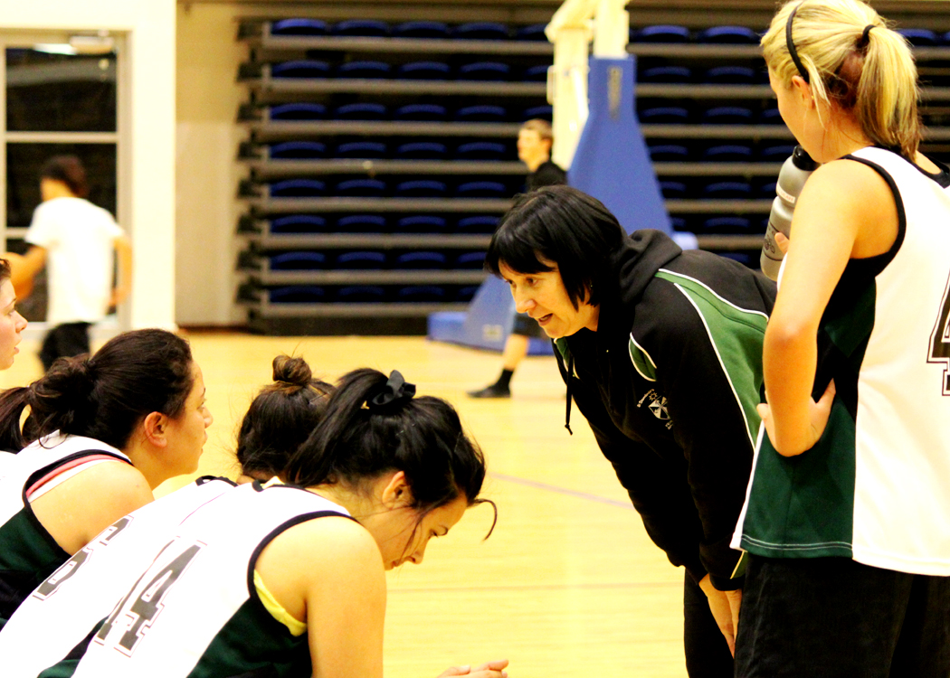

Slide 10
HOCKEY

Slide 11
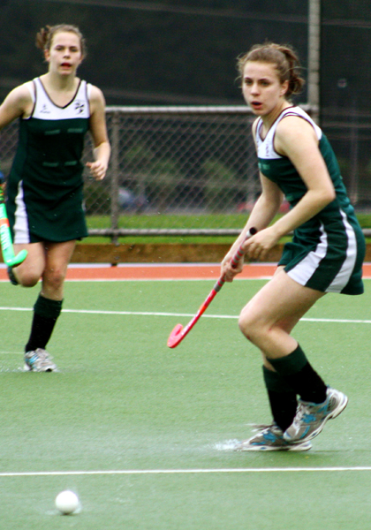
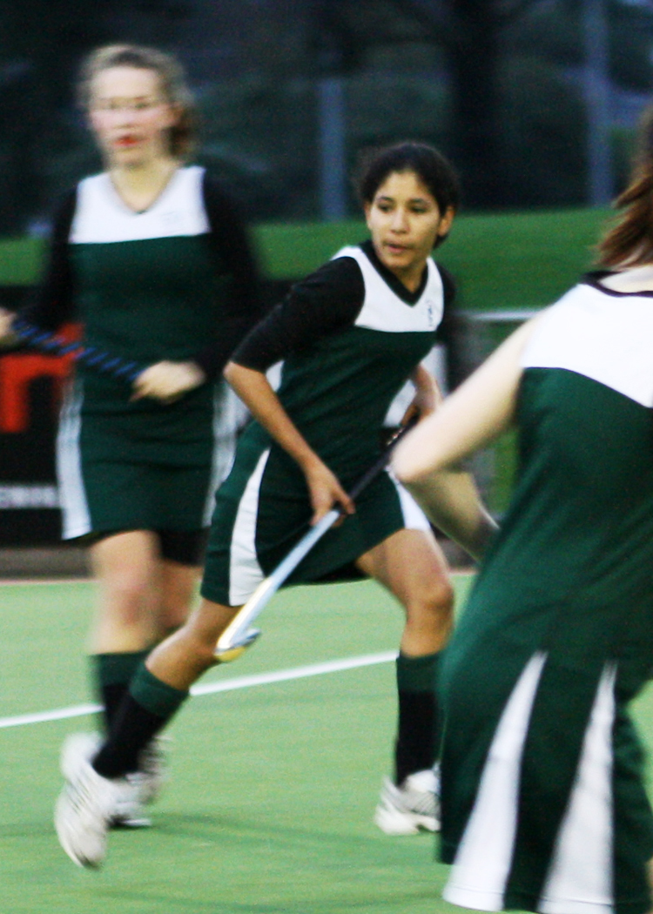
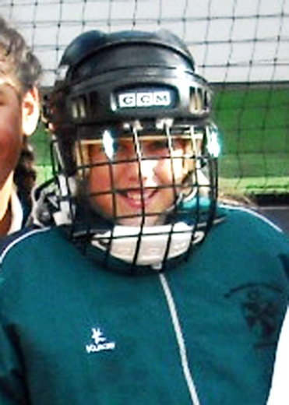
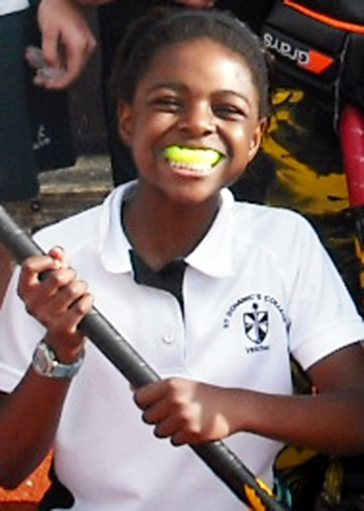

Slide 12
VOLLEYBALL

Slide 13
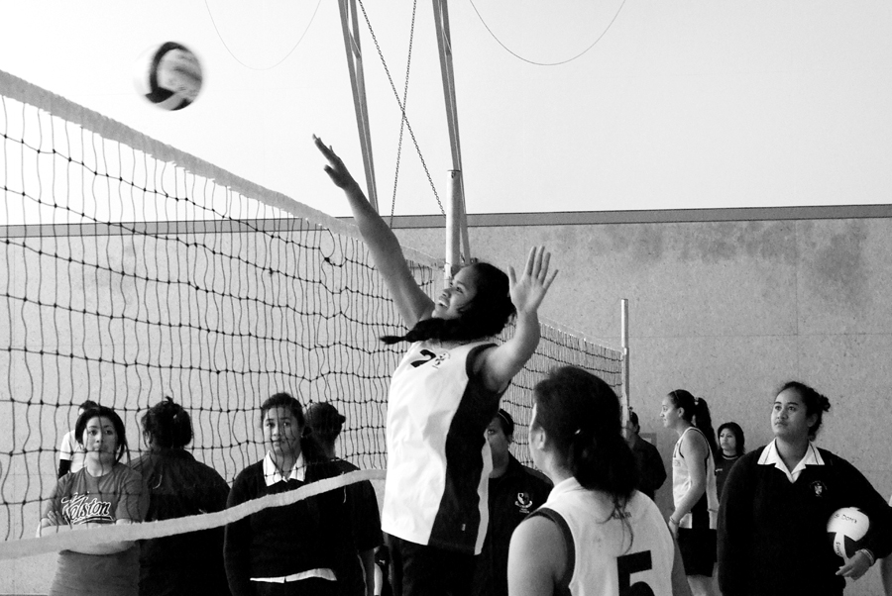
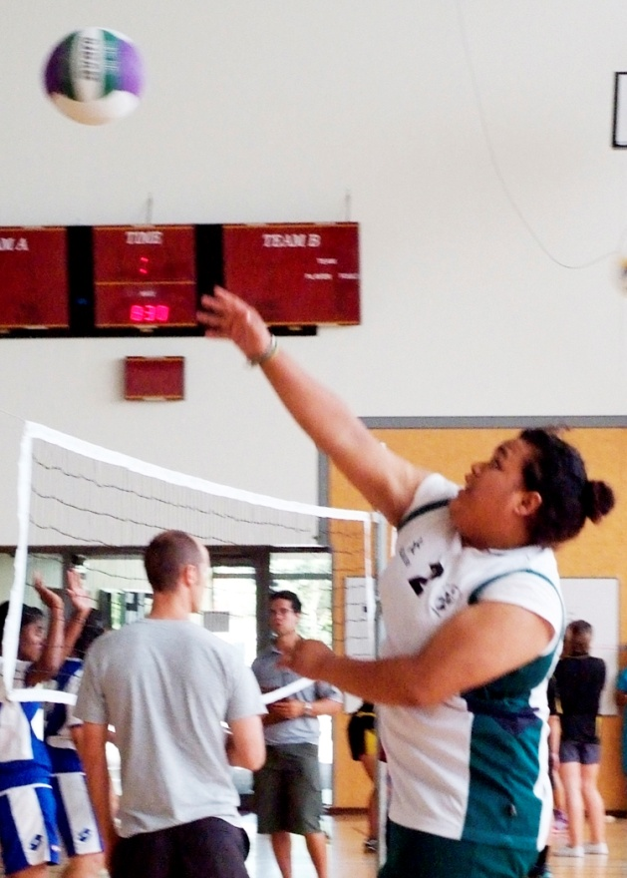

Slide 14
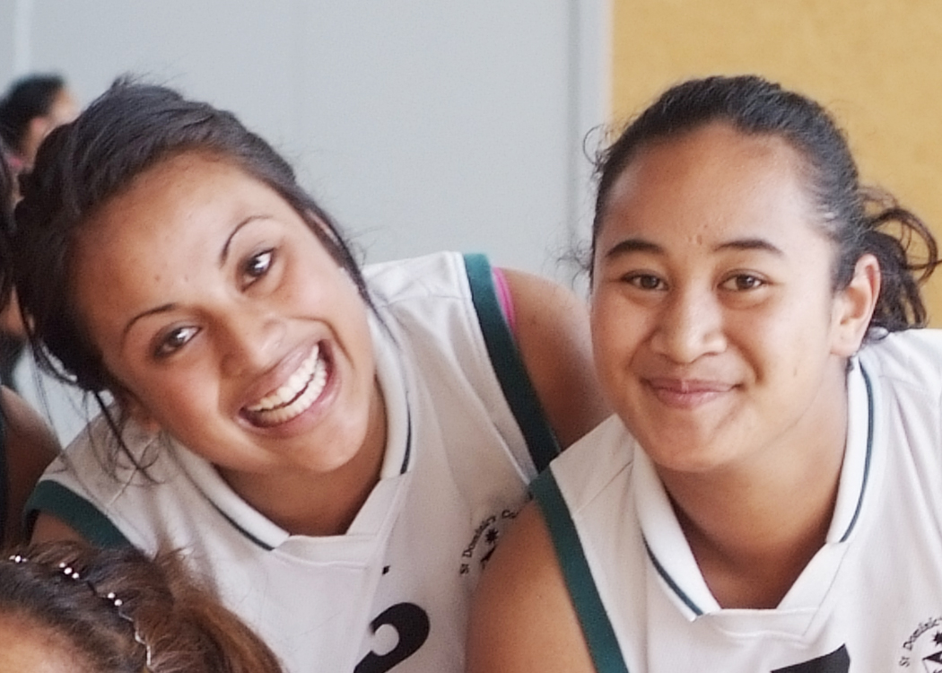

Slide 15
LAWN BOWLS

Slide 16
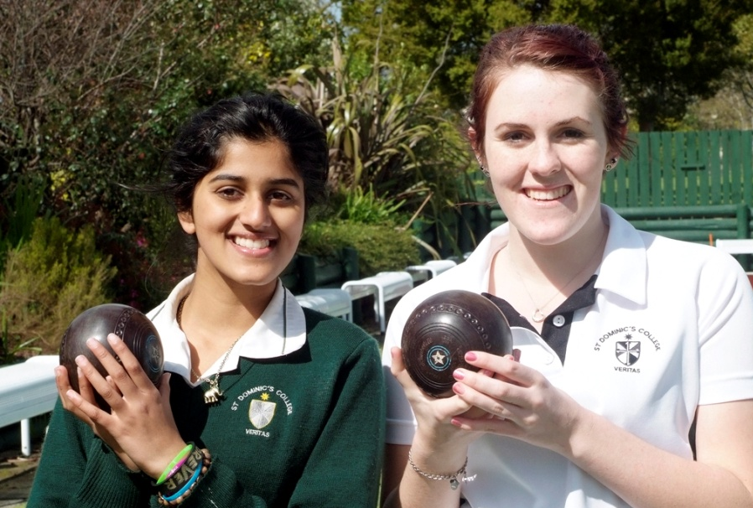
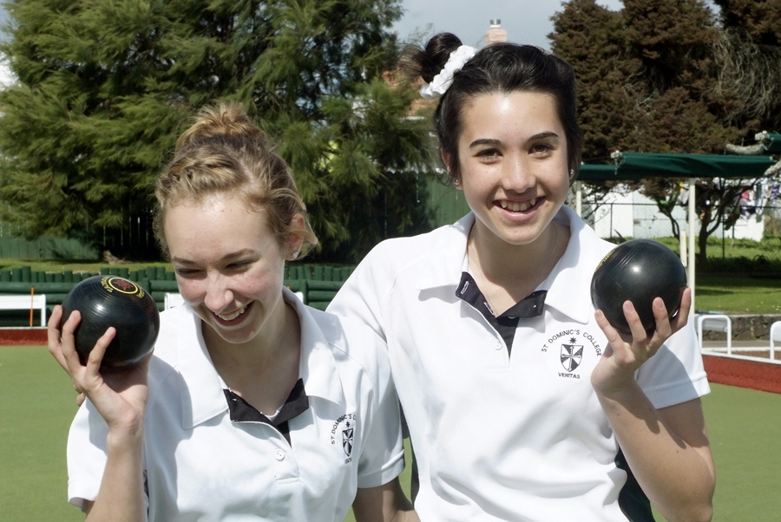
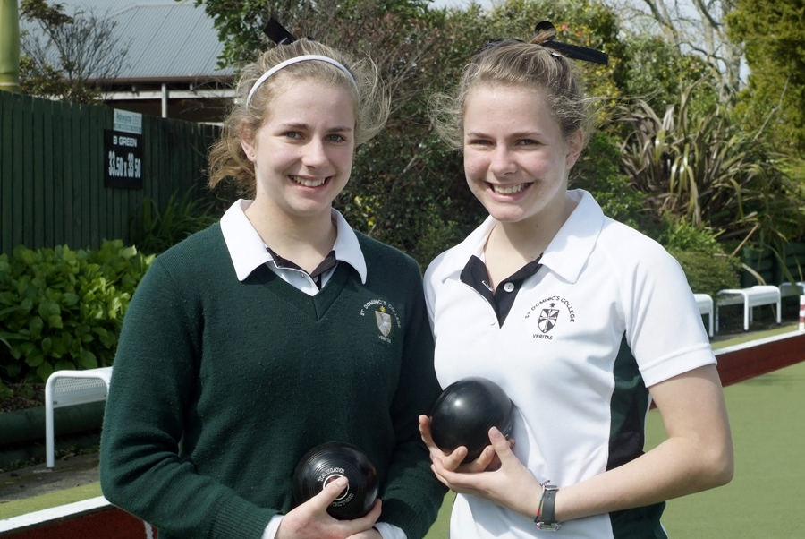
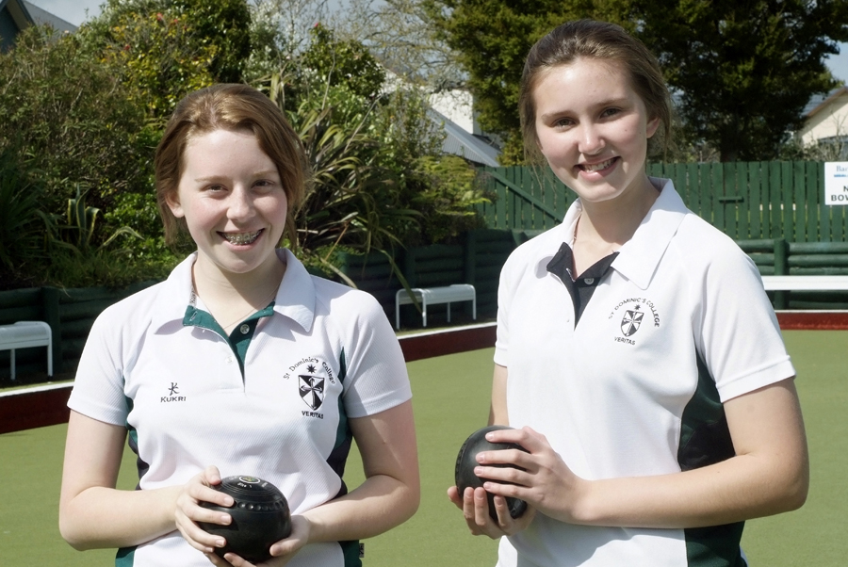

Slide 17
ORIENTEERING

Slide 18
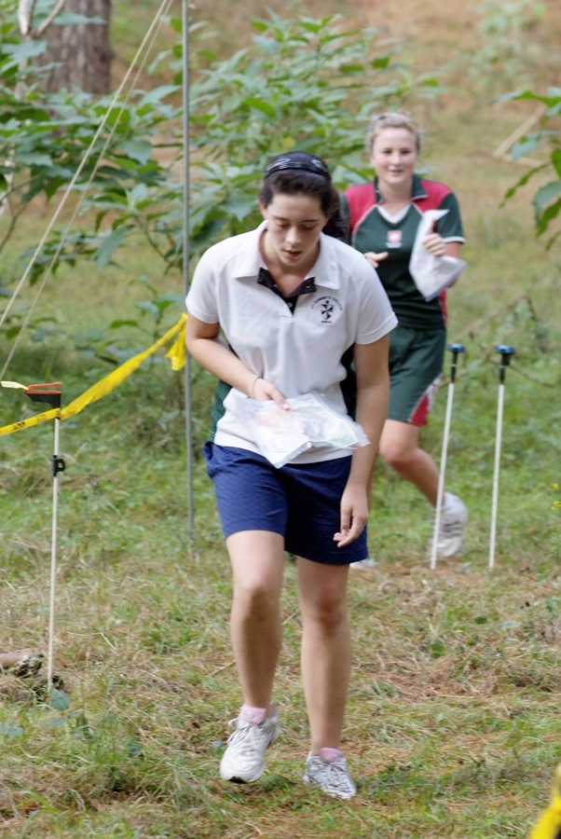

Slide 19
TOUCH

Slide 20
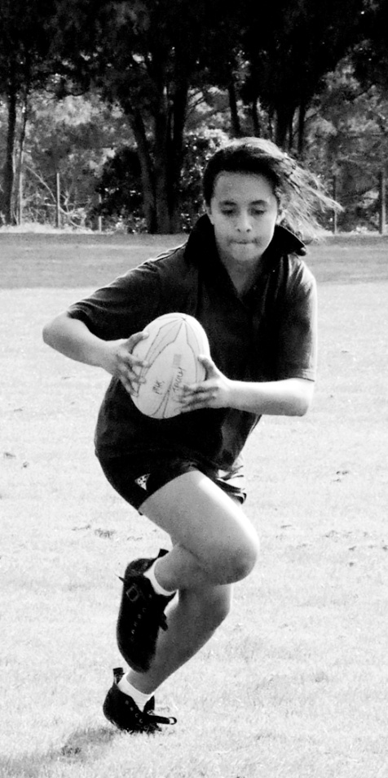
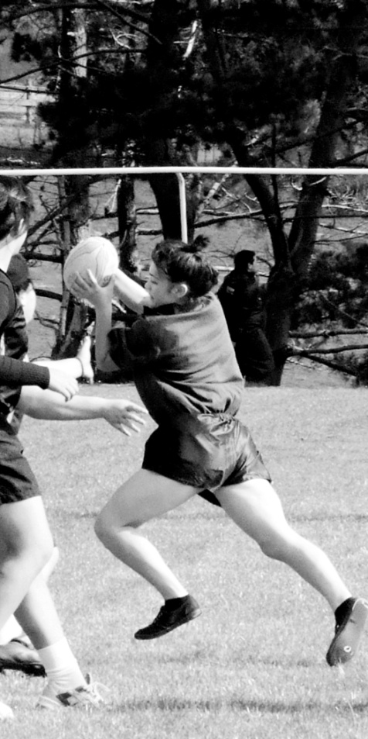
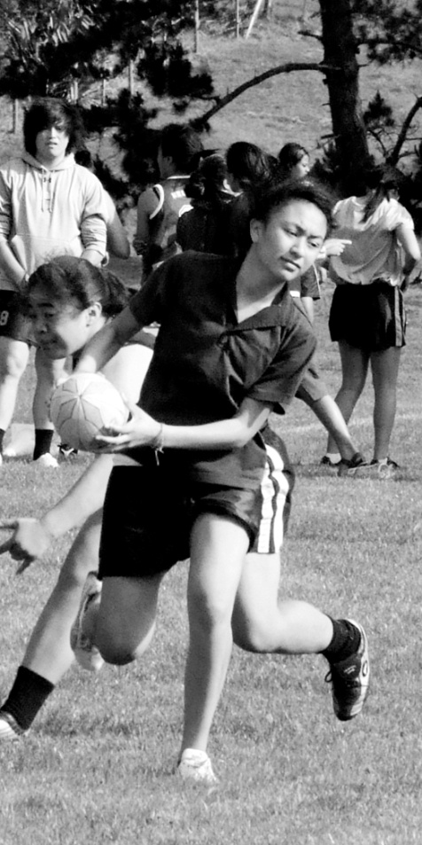
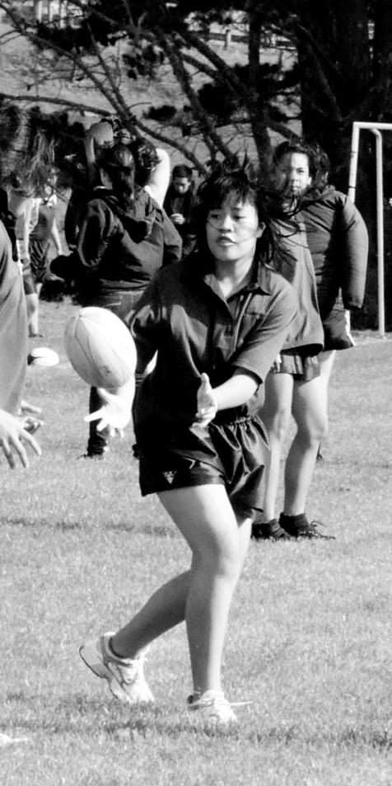

Slide 21
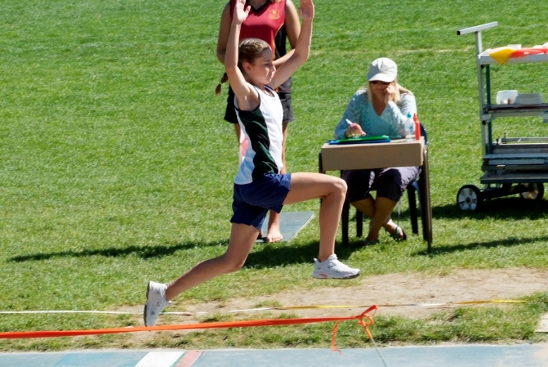
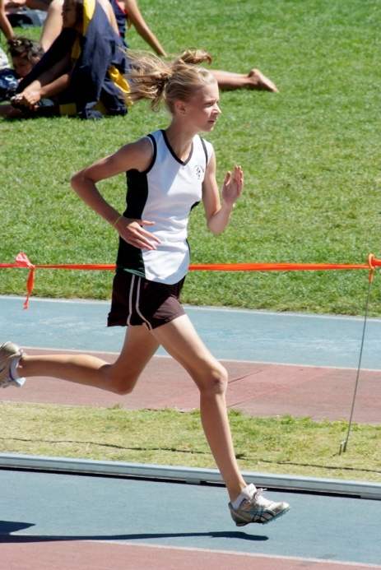
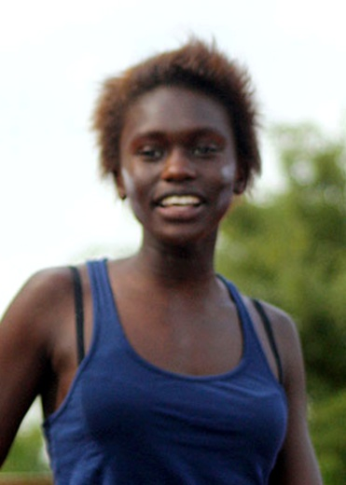
Athletic Champions
Junior – Danielle Moore
Intermediate – Sarah Jones
Senior – Debbie Lado

Slide 22
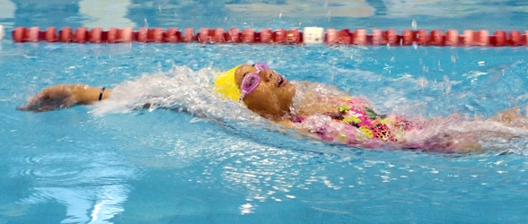
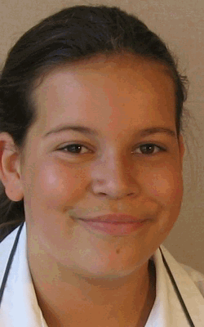
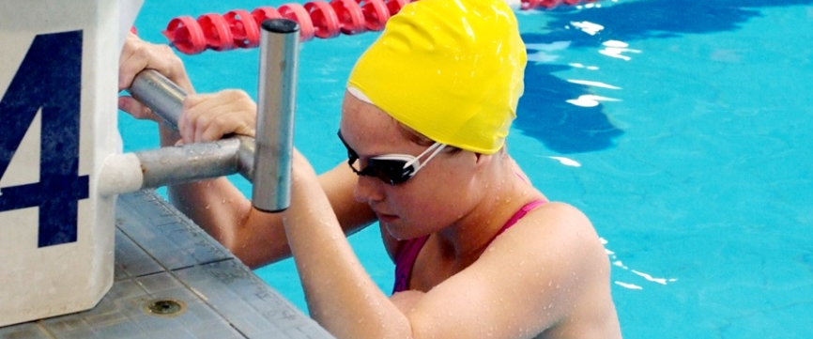
Swimming Champions
U12 – Symone Tafuna`i
O12 – Ashleigh Dine
Junior – Stephanie Jack

Slide 23
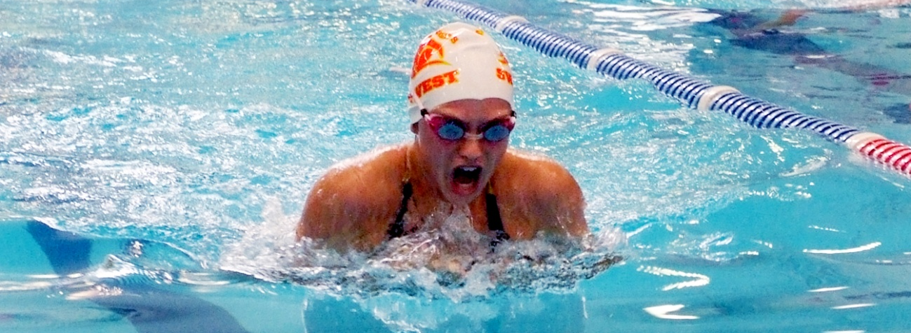
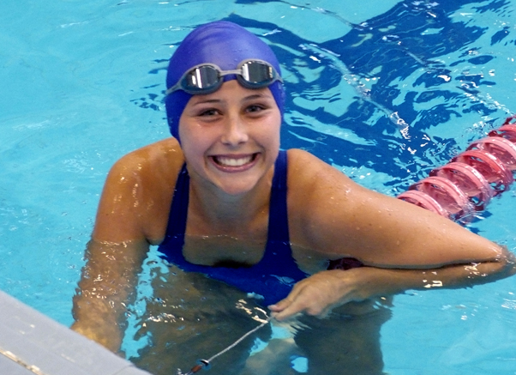
Swimming Champions
Intermediate – Erica McGough
Senior –
Shannen
Tekoronga

Slide 24
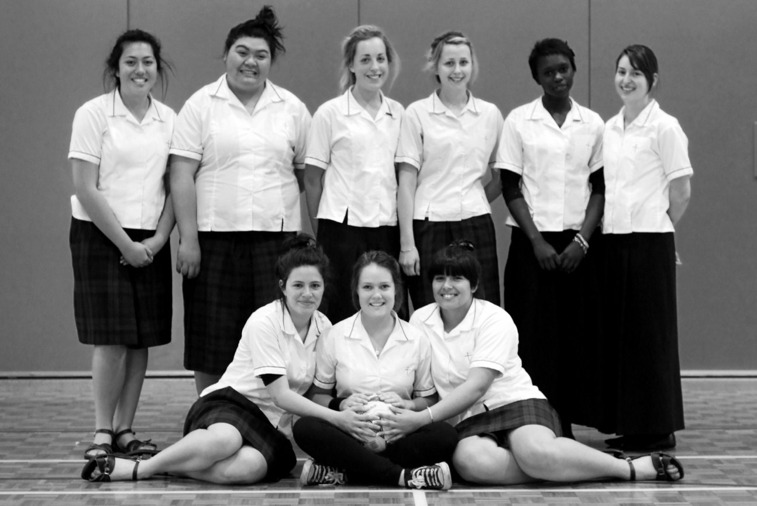
WINNING TEAMS
Netball
  Senior A

Slide 25
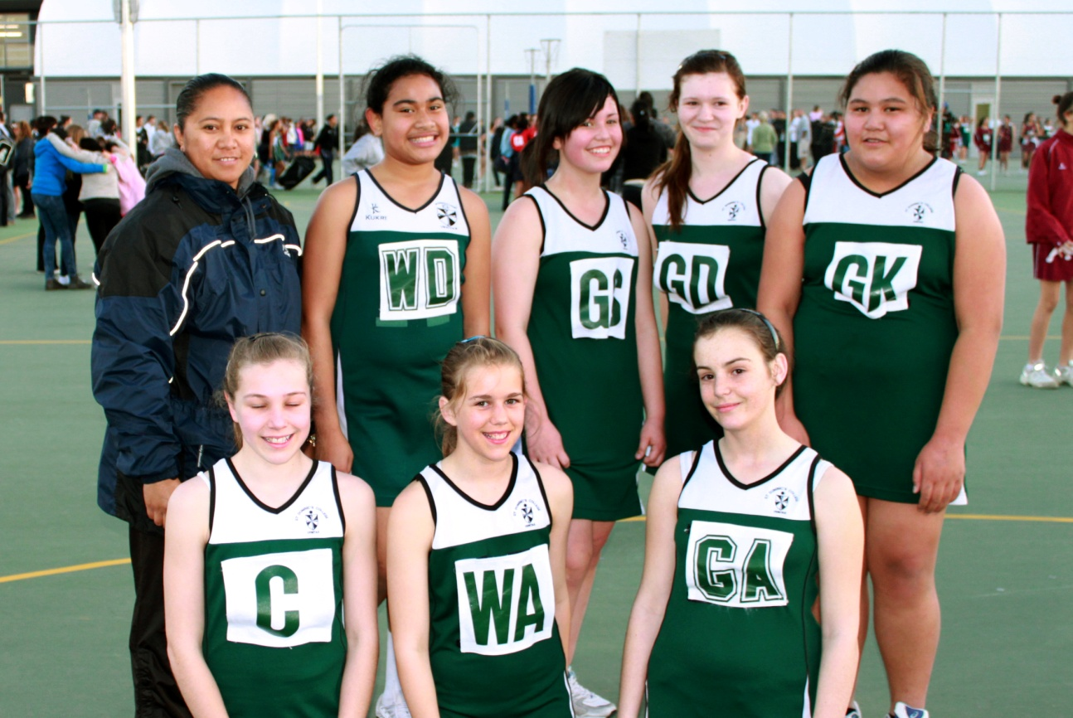
WINNING TEAMS
  Netball
  Year 8B

Slide 26
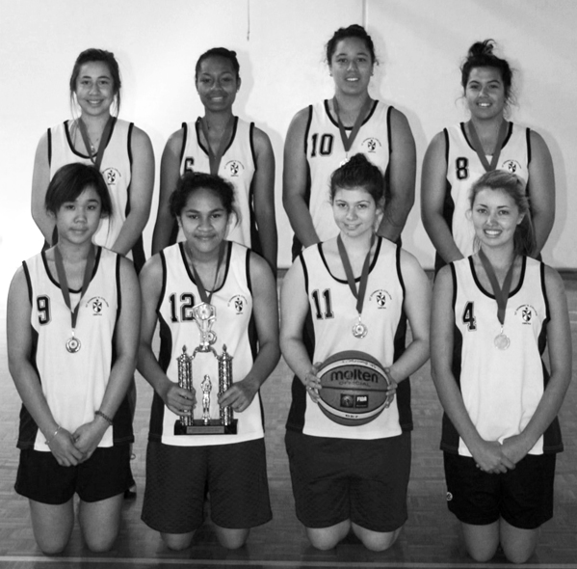
WINNING TEAMS
  Basketball
  Open Team

Slide 27
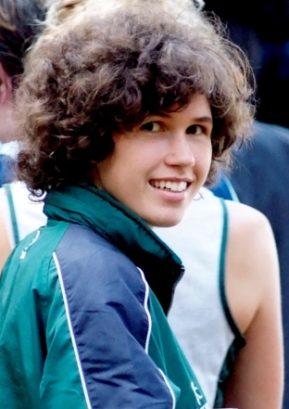
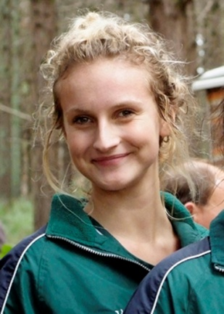
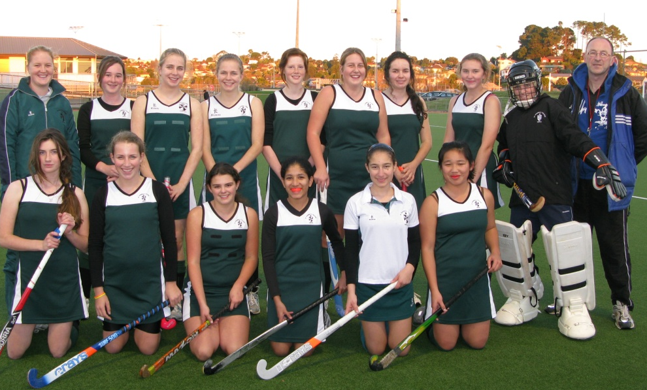
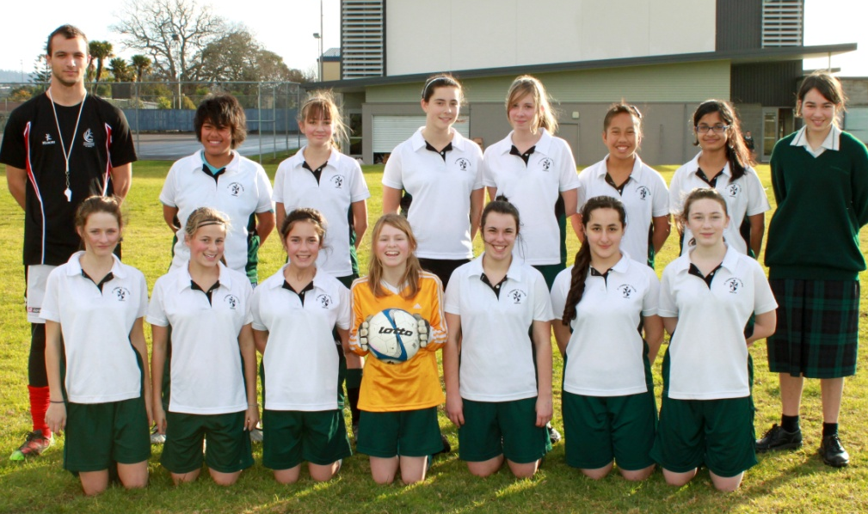
Runner Up Teams
Orienteering –
Secondary Schools
Rogaine Championship
1st XI Hockey Team Junior Soccer Team

Slide 28
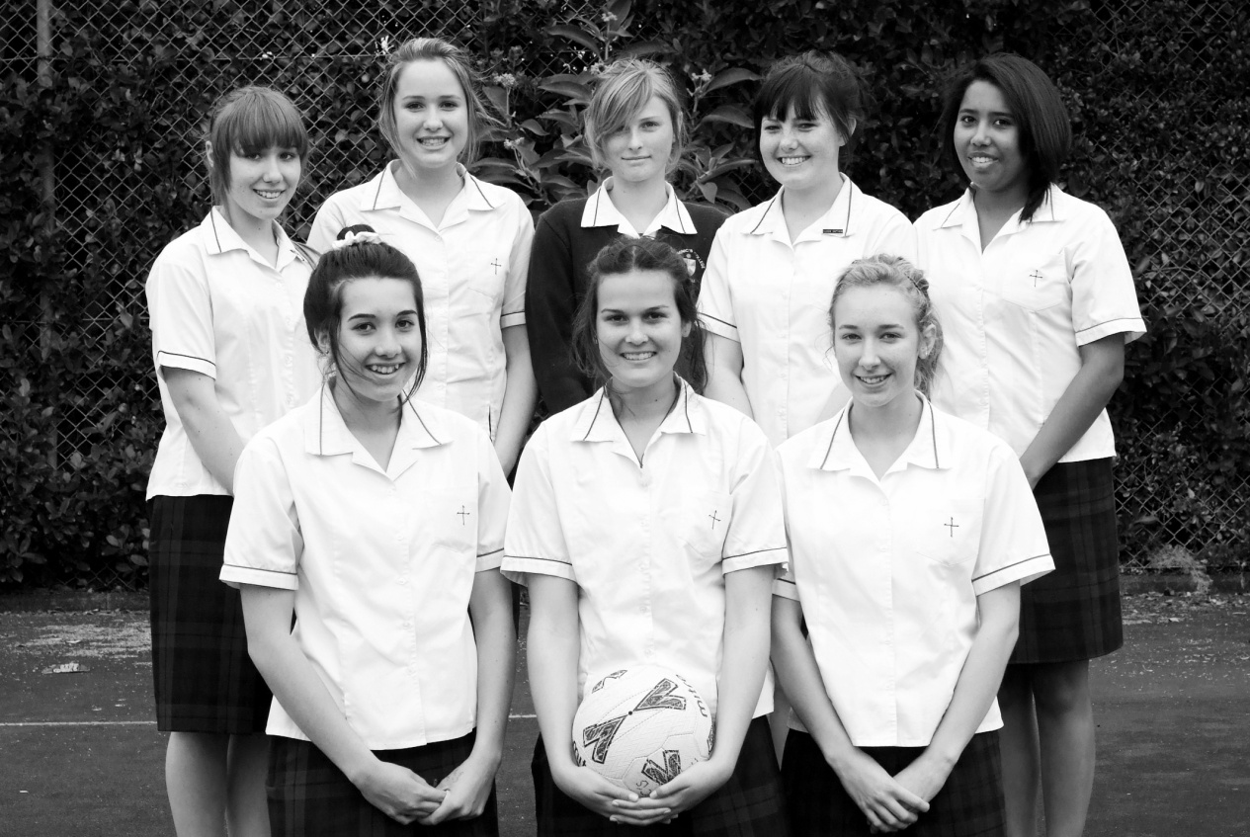
Runner Up Teams
Netball
Senior C

Slide 29
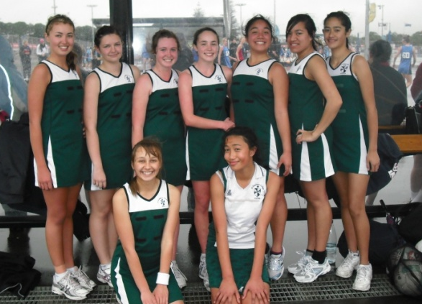



Runner Up Teams
Netball
Year 10A
Year 10B
Year 10E
Year 9A

Slide 30




Runner Up Teams
Netball
Year 8A
Year 8C
Year 8D
Year 7C

Slide 31
Regional Representatives

Slide 32






Netball
  Olivia Sutcliffe – Netball Waitakere
  Jade King – Netball Waitakere
  Lousia Pouanga – Netball Waitakere
  Danielle Thomson – Netball Waitakere
  Nika Brown – Netball Waitakere

Slide 33
Basketball
  Faustina Tuala – U16 New Zealand
  - Waitakere U17 team
  Kuiniseti Seuseu – Waitakere U15 team.
  Ivana Botica – Waitakere U13 team
  Sherilyn Williams – Waitakere U13 team

Slide 34


Slide 35
Lawn Bowls
Heather Blair – Auckland Singles Reps
Tarani Paul & Sadie Sieglaar -
    Auckland Pairs Rep

Slide 36



Slide 37
Soccer
Monique Barnes –
New Zealand Development Squad
Courtney Horler – Auckland U17 team
Candice Roth – Auckland U15 team
Helayna Ogden – Auckland U14 team
Olivia McIver – Waitakere U13 team

Slide 38



Slide 39
Athletics
Jessica Corkill – Auckland Rep
Lasie Koau – Auckland Rep
Auckland Zone:
Sarah Jones
Natalija Senicic
Natalia McNeil
Danielle Moore
Symone Tafunai`i (Intermediate Zone)

Slide 40


Slide 41
Orienteering
Renee Bevridge – Auckland U18 Champion
Helayna Ogden – Auckland B team Rep

Slide 42



Slide 43
Swimming
Auckland Zone Relay Team
Stephanie Jack
Nikisha Lealiifano
Marianna Smoljo
Alyssa Carr
Symone Tafunai`i (Intermediate Zone)

Slide 44




Slide 45

Best first year umpire-
Nikisha Lilliafano

Slide 46

Most Valuable umpire –
Janice Auva`a

Slide 47

Tournament Week Netball Ambassador
Anne Leifi

Slide 48
Sportswomen of the Year
Positive Attitude
Excellent peer role model
High level of Participation in Sport
Excellent fair play ambassador
Leadership Qualities

Slide 49

Yr 7 Sportswoman – Cebile Mpofu

Slide 50

Yr 8 Sportswoman – Monique Barnes

Slide 51

Yr 9 Sportswoman – Olivia McIver

Slide 52

Yr 10 Sportswoman – Helayna Ogden

Slide 53

Yr 11 Sportswoman – Jessica Corkill

Slide 54

Yr 12 Sportswoman – Renee Beveridge

Slide 55

TOP TEAM – Open Basketball Team

Slide 56

Service to Sport within the College – Janice Auva`a

Slide 57

Brodeur Shield – Renee Beveridge

Slide 58

Dux Ludorum – Chantelle Betham

